Slide 2
Advanced
Reproductive Physiology
(for MSc students, Part 3-1)
Presented by: A. Riasi (Associated Professor in Animal Nutrition and Physiology)
Department of Animal Science, College of Agriculture, Isfahan University of Technology

Slide 3
Gamete production in female animals
Two distinct functions for ovaries
Producing the sex steroids and protein hormones:
Prepare the vagina and fallopian tubes
Prepare the lining of uterus
Maintain hormonal support
Act on diverse target organs
Ovogenesis and folliculogenesis:
Maintain and nurture the resident oocyte
Mature the oocyte and release it at the right time

Slide 4
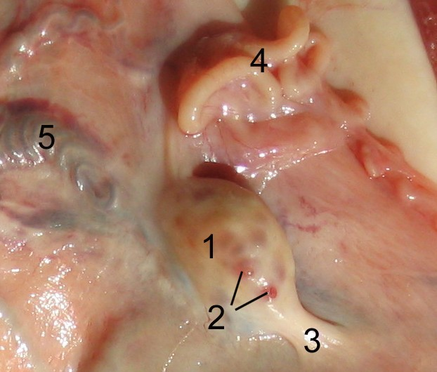
Gamete production in female animals
Fallopian tube
Ovarian artery and vein
Ovarian ligament
Ovary
Tertiary follicle

Slide 5
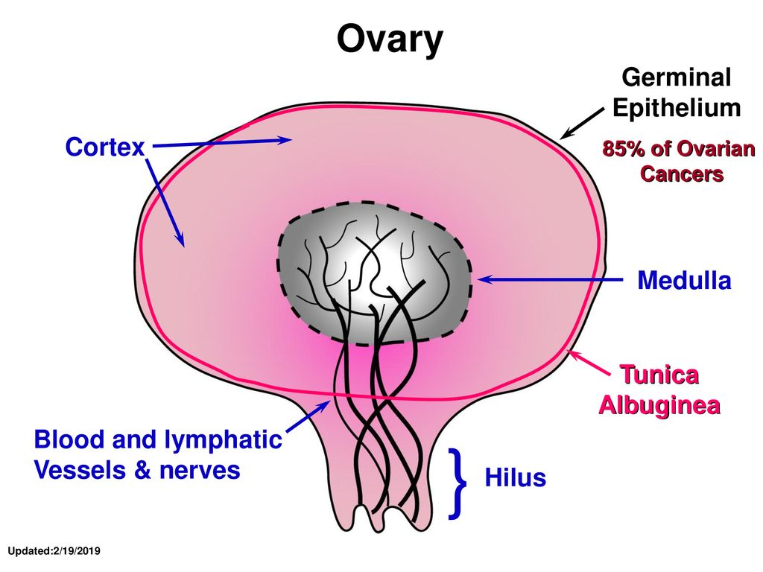
Gamete production in female animals

Slide 6
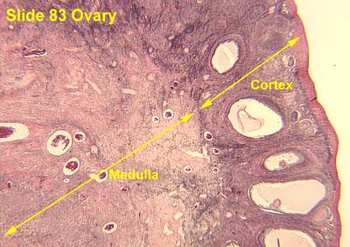
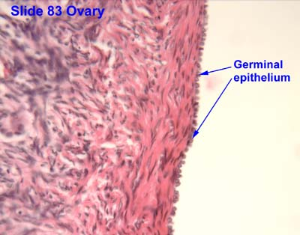
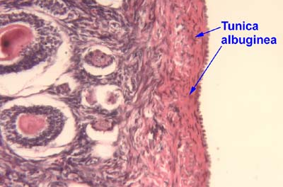
Gamete production in female animals

Slide 7
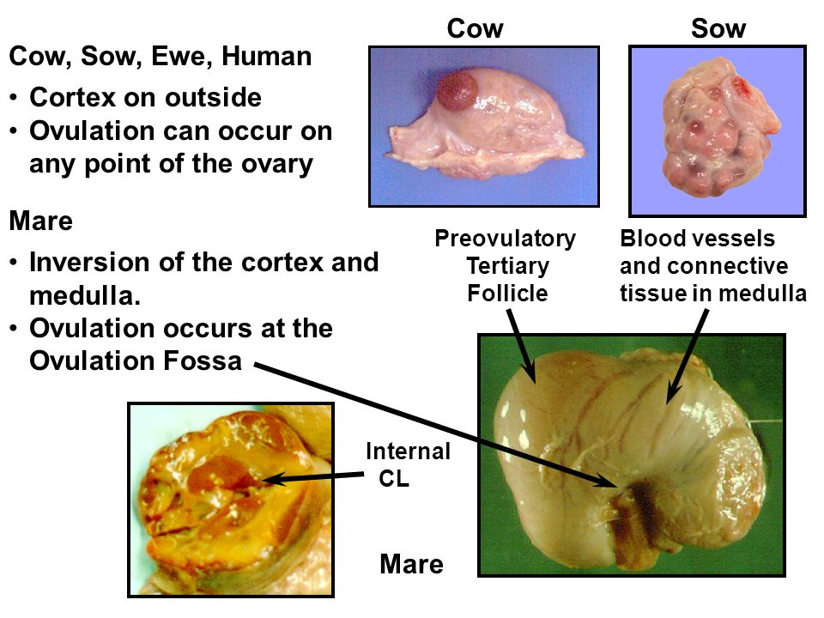
Gamete production in female animals

Slide 8
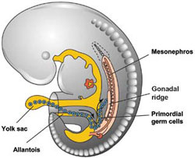
Gamete production in female animals
Ovogenesis is started during the fetal period
Adapted from Kousta et al., 2010
Notes:
The formation of primordial germ cells (PGCs) indicates the commencement of oogenesis. During early fetal life the primordial germ cells which arise in the yolk sac migrate to the presumptive gonads. In cattle the first potential primordial germ cells were identified in an 18-day-old embryo. When the gonadal ridge develops (about day 27) it contains a certain number of primordial germ cells. It is well known that PGCs play an indispensable role in the induction of gonadal development.

Slide 9
Gamete production in female animals
In contrast the male, the female cannot manufacture new oogonia.
It must function with continuously declining number of primary oocytes.

Slide 10
Gamete production in female animals
The first stage of development of the ovarian follicle parallels the prophase of the oocyte.
As an oocyte enters meiosis, it induces a single layer of spindle cells to surround it completely.
Cytoplasmic processes from these cells attach to the plasma membrane of the oocyte.

Slide 11
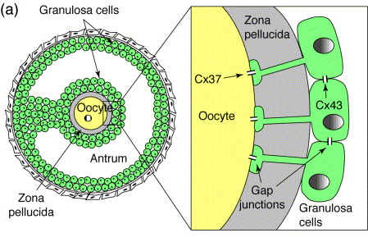
Gamete production in female animals
Notes:
First the spindle-shaped cells become cuboidal and granulosa cells and a primary follicle is formed. Then secondary follicle is created. After that the zona pellucida is formed.

Slide 12
Gamete production in female animals
During the initial deposition of zona pellucida, some changes occur in oocyte:
Formation of cortical granules
Onset of oocyte RNA synthesis
Gonadotrophin responsiveness

Slide 13
Gamete production in female animals
The first stage of follicular occur fetal ovary
Primordial, primary and secondary follicles appear in the fetal ovary on days 90, 140 and 210, respectively.
The second stage of follicular development is take place during in postnatal and in puberty
The third stage of follicular development only after puberty

Slide 14
Gamete production in female animals
Follicular growth in prepubertal heifers occurs in waves.
Each wave is preceded by a peak in serum FSH concentrations (Fortune, 2004).
There is a marked but transient increase in blood concentrations of both LH and FSH.

Slide 15
Gamete production in female animals
From 30-80 days before the first ovulation, the LH pulses frequency result:
Increase in follicle diameter
Increase in serum estradiol concentrations
Enhancing antral follicle development

Slide 16
Gamete production in female animals
The transition to the tertiary follicle includes:
Development of the theca interna and externa
Formation of basal lamina
Formation of cumulus cells
Formation of a fluid-filled antral cavity

Slide 17
Gamete production in female animals

Slide 18
Gamete production in female animals
The different chemicals in antrum fluid:
Mucopolysachrides
Plasma proteins
Electrolytes
Glycosoaminoglycans
Proteoglycans
Gonadal steroid hormones
FSH, Inhibin and other factors

Slide 19
Gamete production in female animals
Final stage of follicular development occurs only in the postpubertal reproductive ovary:
The granulosa cells spread apart
The cumulus oophorus loosens
The follicle generally ruptures, releasing the oocyte with adherent cumulus oophorus
At this time the initial meiotic division complete

Slide 20
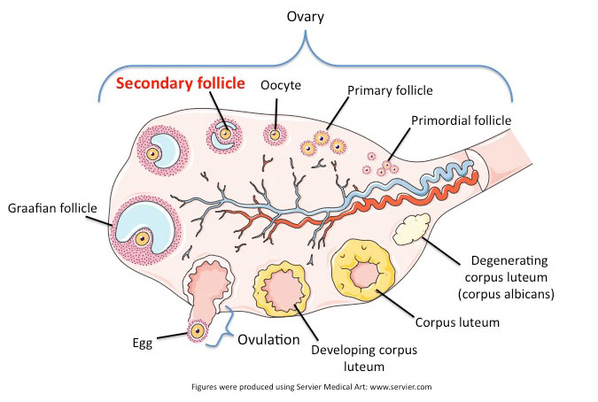
Gamete production in female animals

