Slide 1


Slide 2


Advanced
Reproductive Physiology
(for MSc students, Part 5-2)
Presented by: A. Riasi (Associated Professor in Animal Nutrition and Physiology)
Department of Animal Science, College of Agriculture, Isfahan University of Technology

Slide 3

Physiology of parturition

Slide 4
Physiology of parturition

Slide 5
Physiology of parturition
Plasma cortisol concentration changes during sheep gestation (Yuen et al. 2004)

Slide 6
Physiology of parturition
Prepartum increase in circulating cortisol is required for the differentiation and maturation of key fetal organs:
  Lung
  Liver
  Kidney
  Brain

Slide 7
Physiology of parturition
The endocrine changes cause two major events to occur:
  Removal of the myometrial “progesterone block” enabling myometrial contractions to begin
  Increased reproductive tract secretions particularly by the cervix

Slide 8
Physiology of parturition
Effect of fetal corticoids:
  Converting progesterone to estradiol
  Synthesizing PGF2α by placenta
    As both estradiol and prostaglandin become elevated, the myometrium becomes increasingly more active
    The CL of pregnancy regress

Slide 9
Physiology of parturition

Slide 10
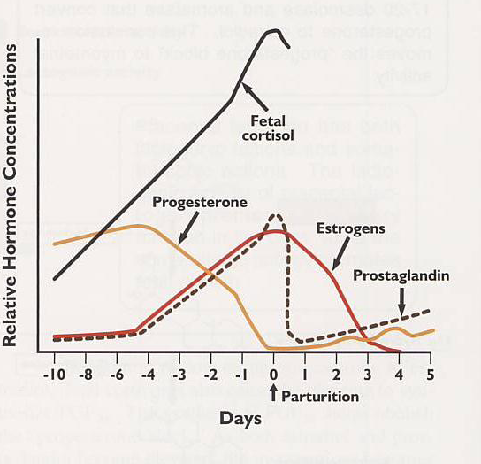
Physiology of parturition
Relative hormone profiles in the cow during the periparturient period

Slide 11
Physiology of parturition
In pre-parturition period birth canal is lubricated by:
  Mucus secretion in cervix and vagina
  Fetal membrane rupture and loss of amniotic and allantoic fluid

Slide 12
Physiology of parturition
As the fetus enters the birth canal, it becomes hypoxic
Hypoxia promotes fetal movement that, in turn, promotes further myometrial contraction

Slide 13
Physiology of parturition
In most species, expulsion of the fetal membranes quickly follows expulsion of the fetus
It is believed that vasoconstriction of arteries in villi reduces pressure and thus allows the villi to be release from the crypts

Slide 14
Physiology of parturition
Prolonged parturition can result in serious complications to both the fetus and dam.
Different causes for dystocia:
  Excessive size of fetus
  Failure of proper fetal ritation
  Multiple births in monotocous species

Slide 15
Some research papers associated to this lecture
Leibovicha, H., et al. 2001. Effects of recombinant ovine placental lactogen and recombinant ovine growth hormone on growth of lambs and milk production of ewes. Livestock Production Science 68: 79–86.
Probo, M., et al. 2011. Peripartal Hormonal Changes in Alpine Goats: a Comparison Between Physiological and Pathological Parturition. Reprod Dom Anim 46: 1004–1010.
Leury, B. J., et al. 2003. Effect of insulin and growth hormone on plasma leptin in periparturient dairy cows. Am. J. Physiol. Regul. Integr. Comp. Physiol. 285: 1107–1115.
Murawski, M., et al. 2011. Cortisol, progesterone and estradiol secretion in vitro in postpartum placental cotyledons of ewes that gave birth to single or twin lambs. Ann. Anim. Sci., 11: 53–60.

